Slide 1

Adventure Works
Prepared by Arwa Elsharawy

Slide 2

Agenda
Project Description
Project Phases and tools
Data Integration
Data Analysis and Visualization

Slide 3


Project Description
Adventure Works:
Adventure Works Cycles is a multinational company for bikes manufacturing, the company continues to grow.
Business Intelligence Solution
They demand an End-To-End Business Intelligence Solution
to track and analyze their sales for a better decision-making.

Slide 4


Project Phases and tools
Data Integration
Data Analysis and Visualization
Populate the analytical data warehouse storage.
Sales Report showing summary of sales and most important KPIs.
Tools
Tools
SQL Server Integration Services
“SSIS”.
Microsoft Power BI.

Slide 5
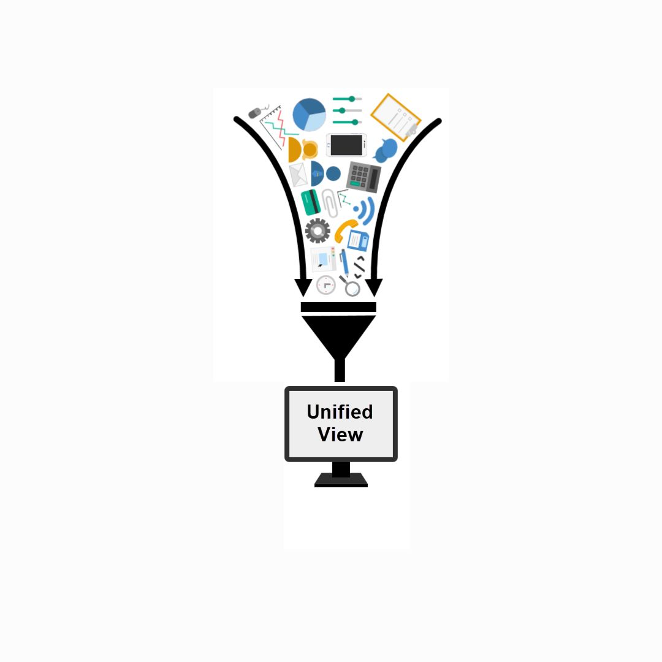
Data Integration
Definition:
Data integration focuses on collecting, processing, and managing data to make it accessible, reliable, and useful for various business purposes.
Process:
Data integration involves combining data from multiple sources, transforming it into a consistent format, and then loading it into a target system, such as a data warehouse or a data lake.
Goal:
This process enables organizations to have a unified view of their data and supports better decision-making, reporting, and analytics.
Tools
SQL Server Integration Services “SSIS”.

Slide 6
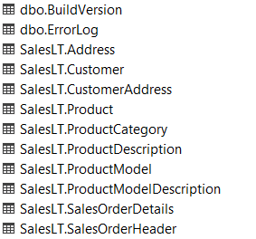

Data Integration
Given OLTP Database:
Design and Populate a Data Warehouse for monitoring and analyzing historical sales.

Slide 7
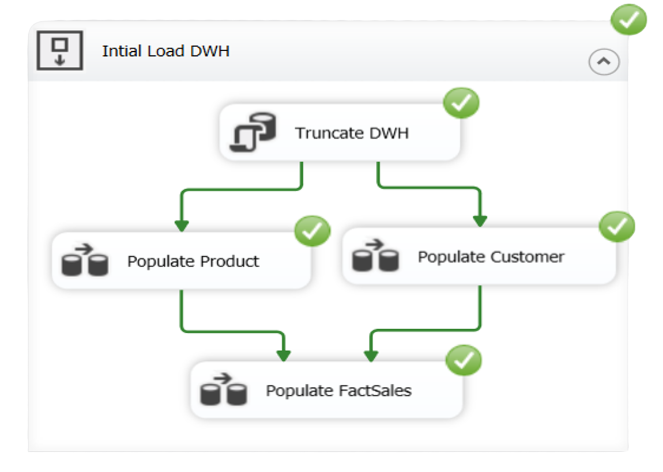
Data Integration
1.Design the Control Flow
1. Truncate DWH :
To ensure that the table is reset to a clean state, preventing any residual data from previous loads from causing errors or inconsistencies.
2. Populate in Parallel Both
Customer and Product
3. Finally Populate Fact Sales

Slide 8
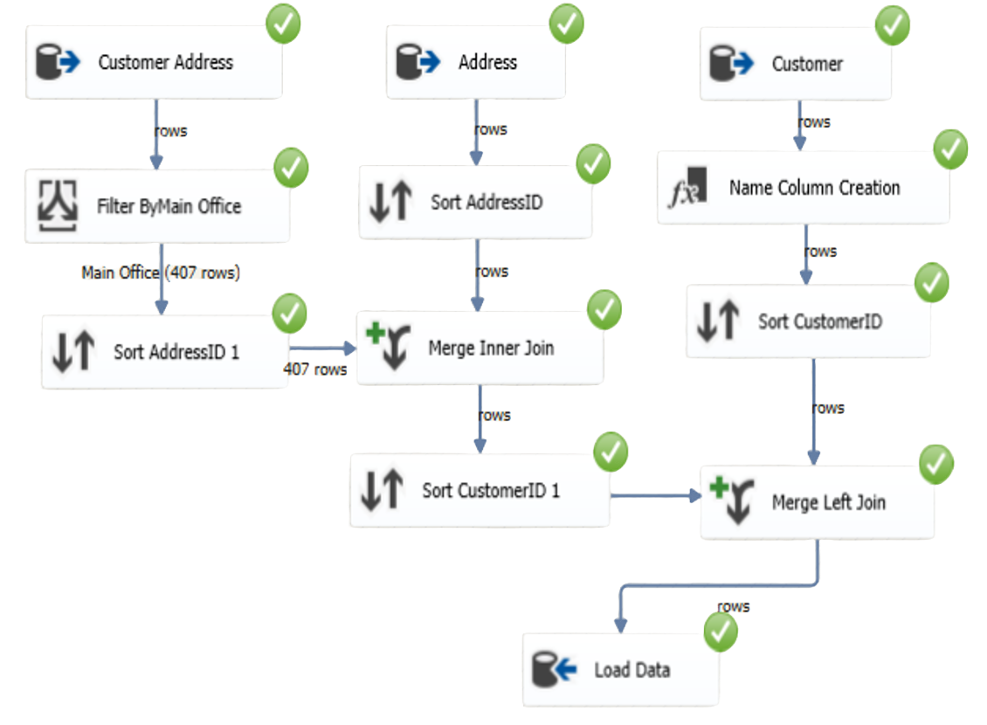
Data Integration
2. Design the Data Flow “Customer”
ETL (Extract, Transform, Load) process
1. Extract:
Extract data from various source systems (e.g., Customer Address, Address, and Customer tables).
2. Transform:
Apply necessary transformations to the extracted data. This can include filtering, sorting, joining tables, and adding new columns
3. Load:
Load the transformed data into the target destination (e.g., a final table in the data warehouse).

Slide 9
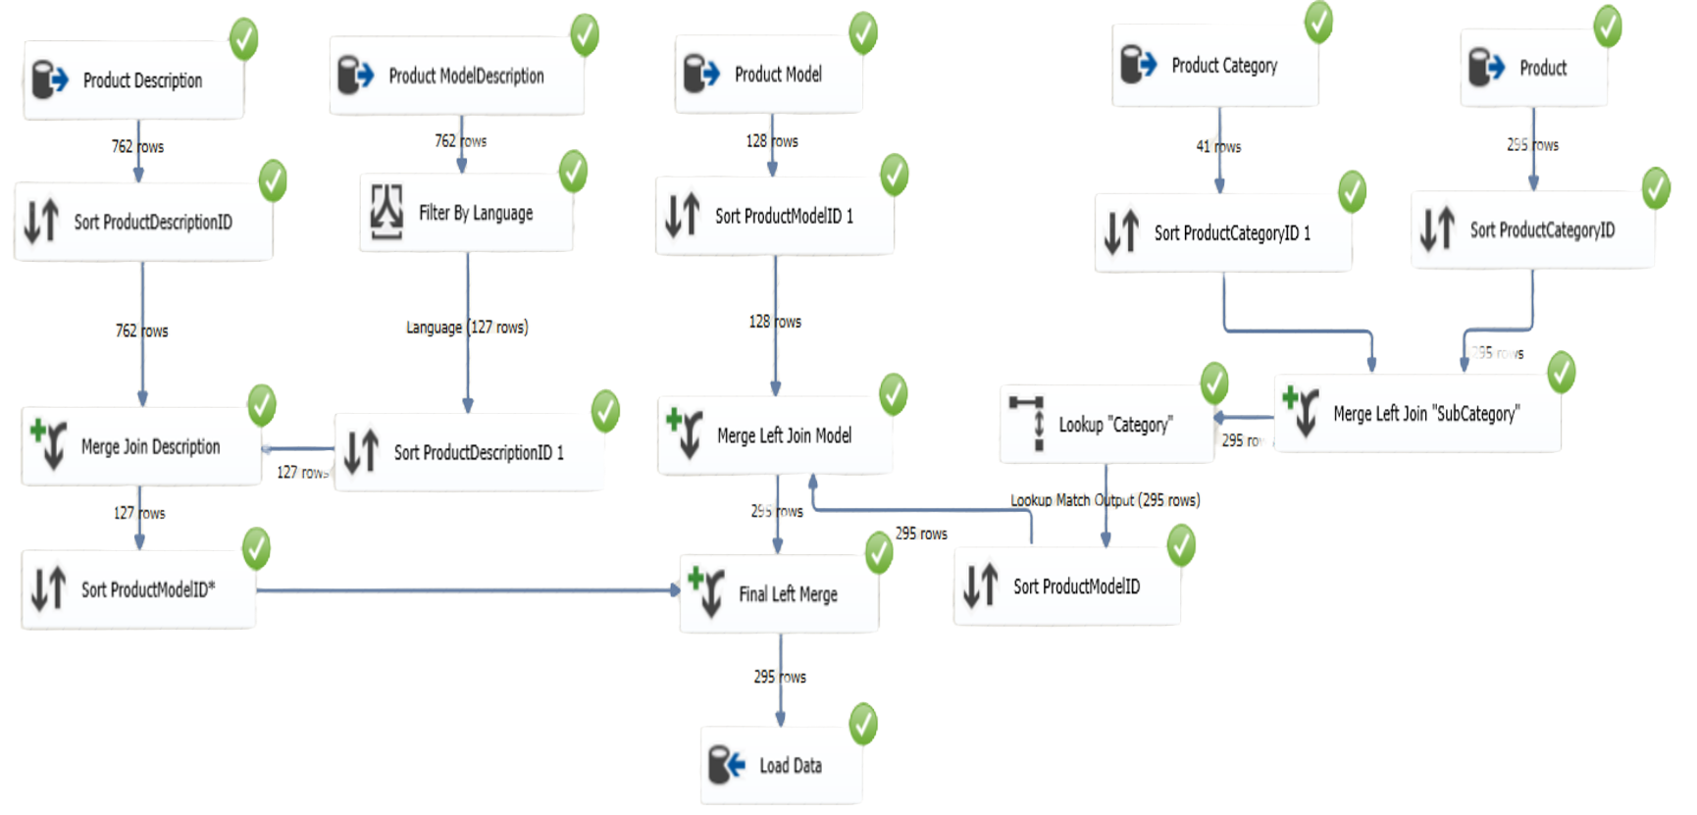
Data Integration
2. Design the Data Flow “Product”
ETL (Extract, Transform, Load) process
1. Extract:
Extract data from various source systems (e.g., Product ,Description, Model Description, Model, and Category tables).
2. Transform:
Apply necessary transformations to the extracted data. This can include filtering, joining tables, looking up and sorting.
3. Load:
Load the transformed data into the target destination (e.g., a final table in the data warehouse).

Slide 10
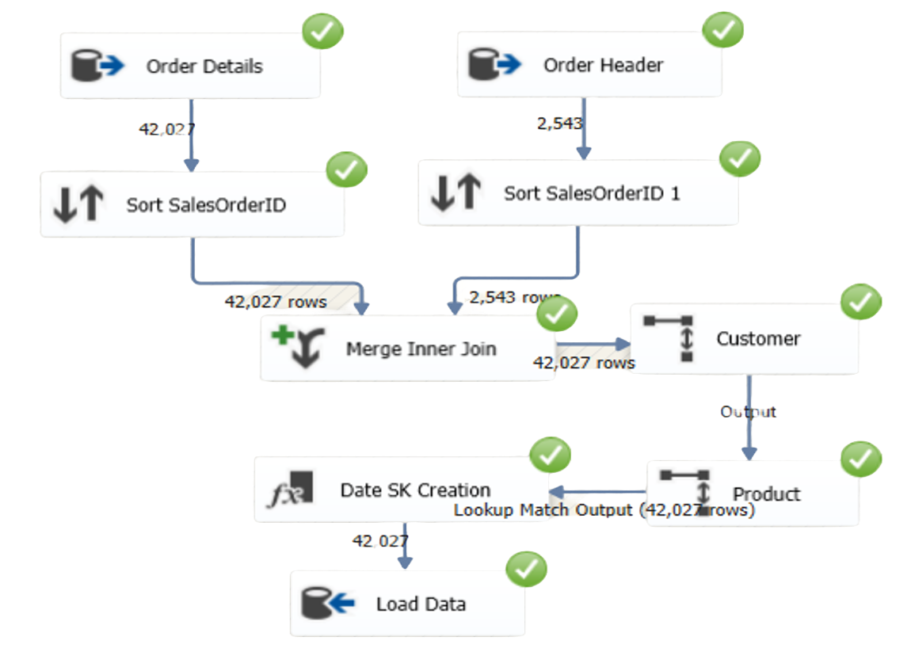
Data Integration
2. Design the Data Flow “Sales”
ETL (Extract, Transform, Load) process
1. Extract:
Extract data from various source systems (e.g., Order Details , and Order Header tables).
2. Transform:
Apply necessary transformations to the extracted data. This can include sorting, joining tables, looking up, and adding new columns.
3. Load:
Load the transformed data into the target destination (e.g., a final table in the data warehouse).

Slide 11

Data Analysis and Visualization
Goal
Transform raw data into meaningful insights that drive better business outcomes through effective data analysis, visualization, and collaboration.
Tools
Microsoft Power BI.

Slide 12
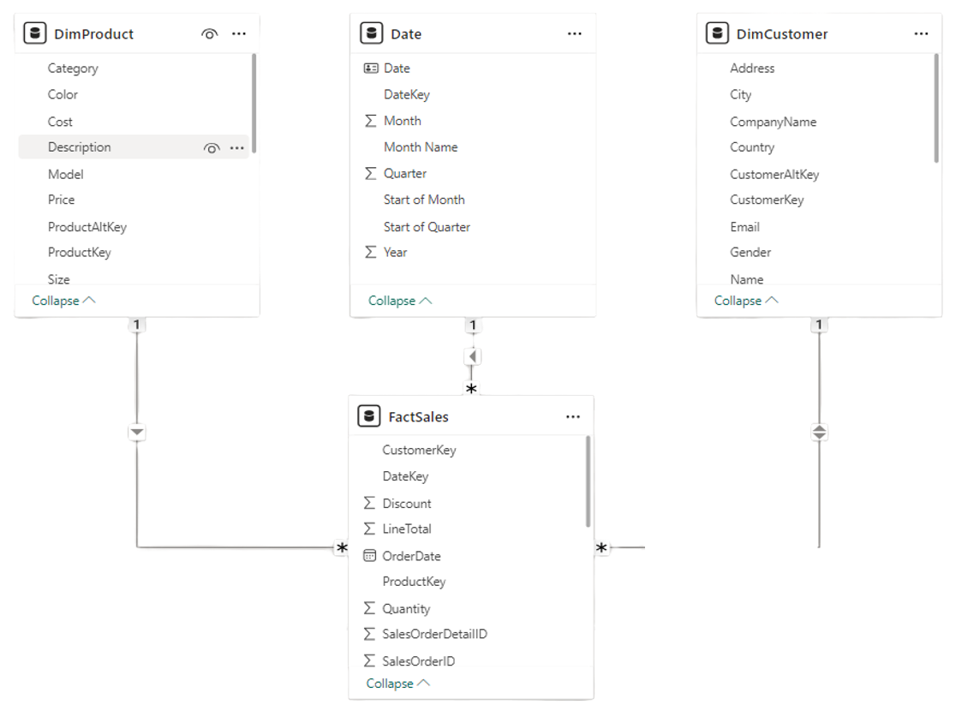
Data Analysis and Visualization
1. Data Model
Star Schema
1. Fact Table:
The fact table is the central table in a star schema. It contains quantitative data (measures) for analysis
2. Product and Customer Tables (Dimensions):
The tables contain descriptive information about Products and Customers.
3. Date Table (Dimension):
Also known as a time dimension .
It is used to analyze data across different time periods.

Slide 13
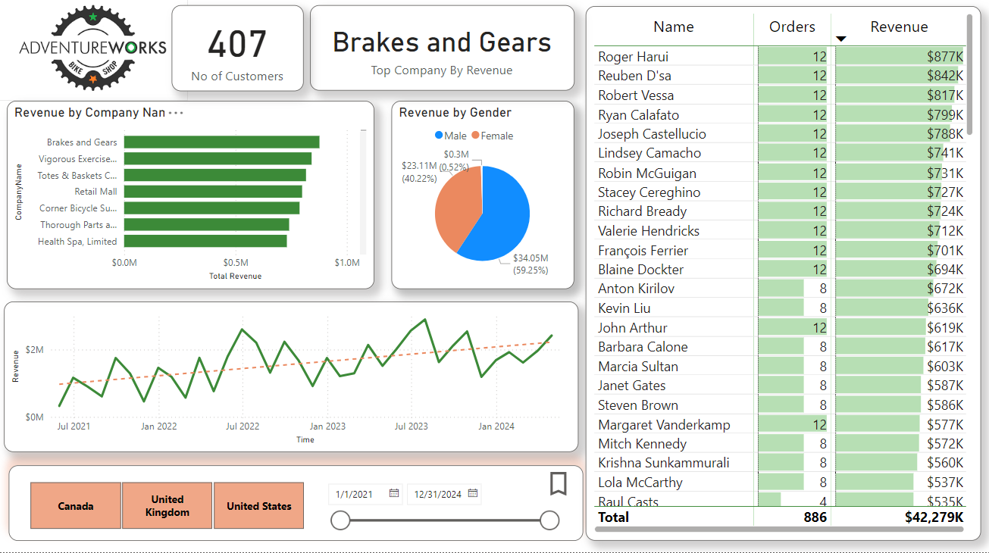
Data Analysis and Visualization
2. Report “Customer”:

Slide 14
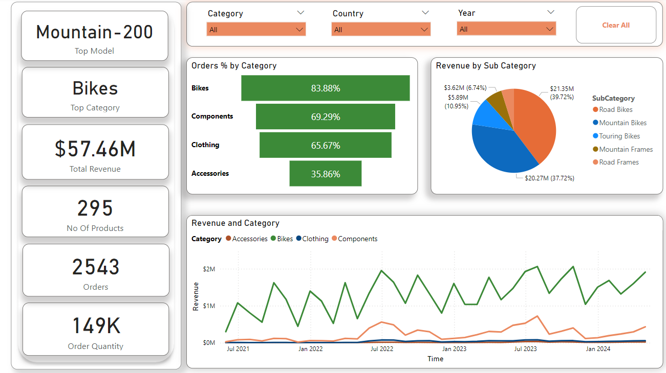
Data Analysis and Visualization
2. Report “Product”:

Slide 15
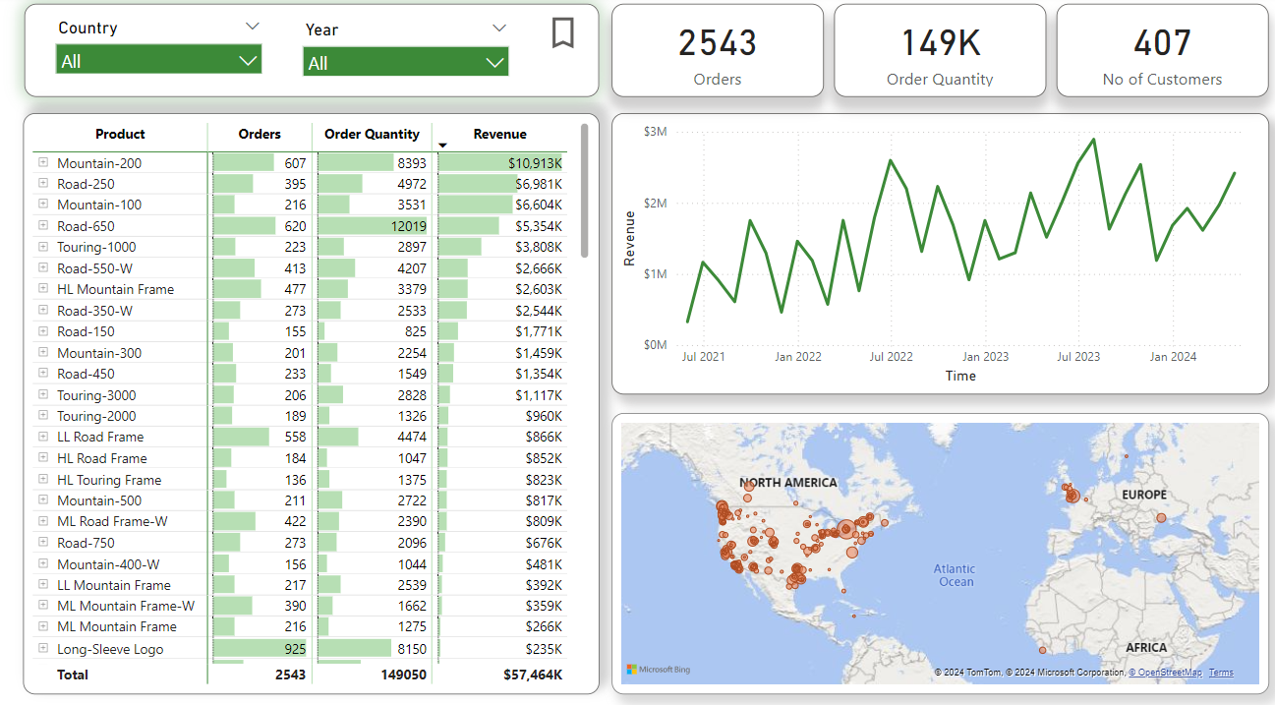
Data Analysis and Visualization
2. Report “Product*”:

Slide 16
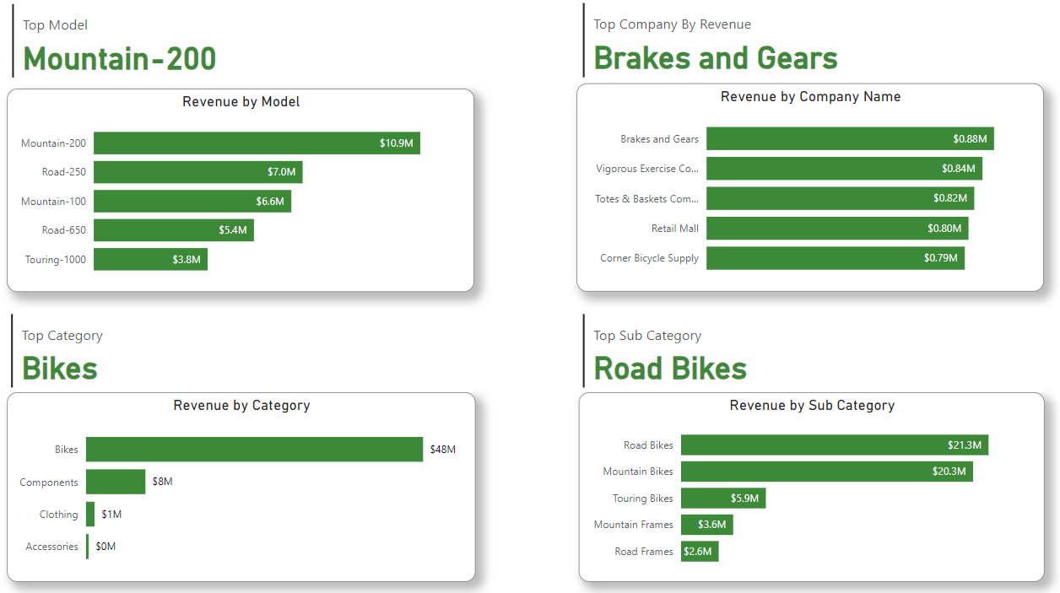
Data Analysis and Visualization
2. Report “Overall insights”:

Slide 17
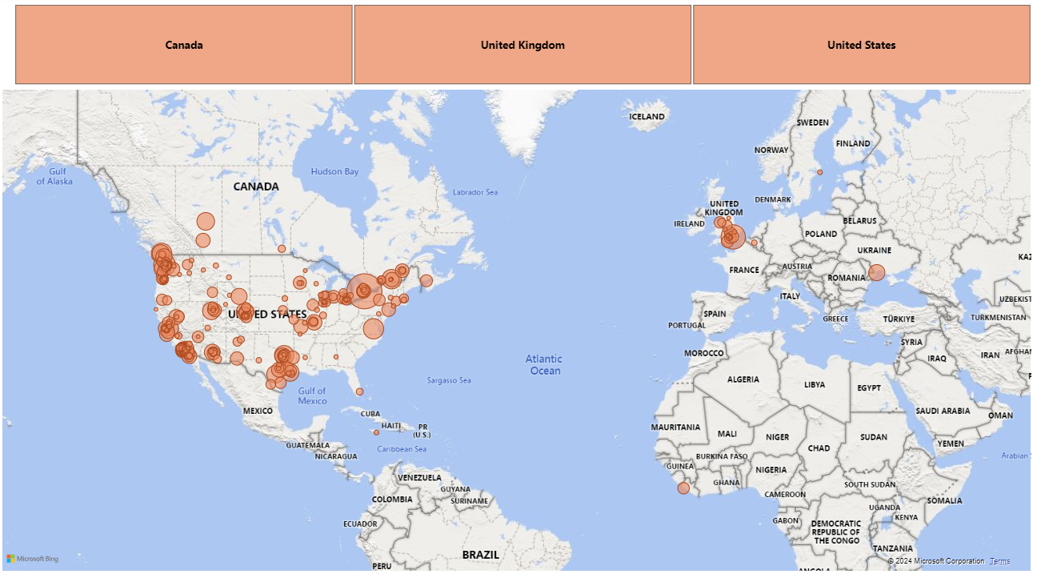
Data Analysis and Visualization
2. Report “Overall insights*”:

Slide 18
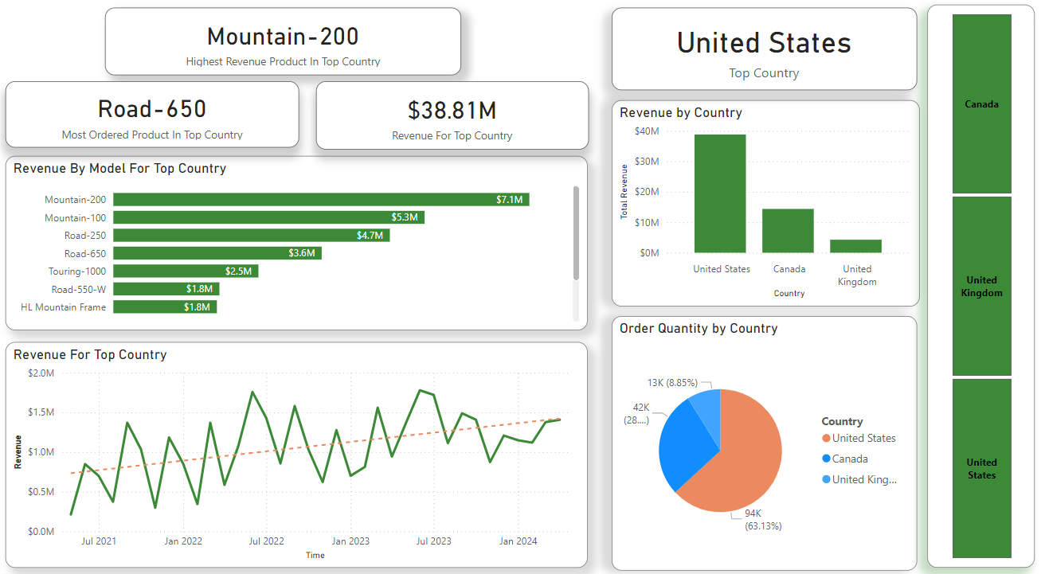
Data Analysis and Visualization
2. Report “Overall insights**”:

Slide 19
Thank you

